Slide 1
Results Analysis
(Summary)

Slide 2
The Hardware
Core i5 4670k
Quad Core
3.4 GHz (Over clocked)
Water cooled

Slide 3
One more thing...
The following results were obtained by using a 5x5 Gaussian blur kernel matrix on the image set
We should also note that the time taken to read from and write to files have been excluded.

Slide 4
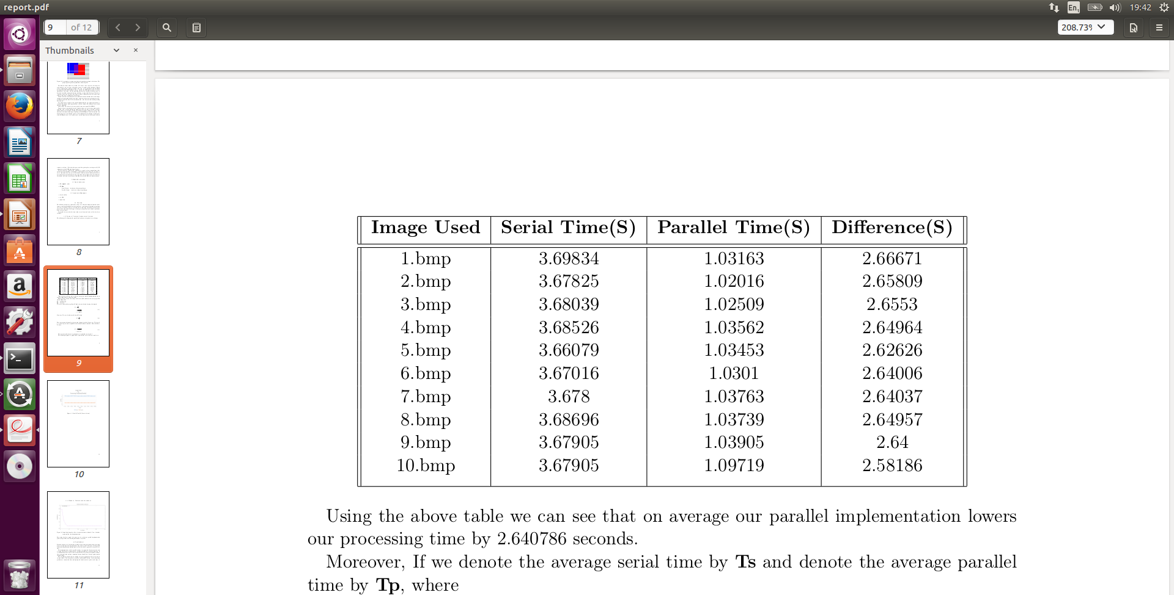
Serial vs. Parallel (4 threads)
Using the above table we can see that on average our parallel implementation lowers our processing time by 2.640786 seconds

Slide 5
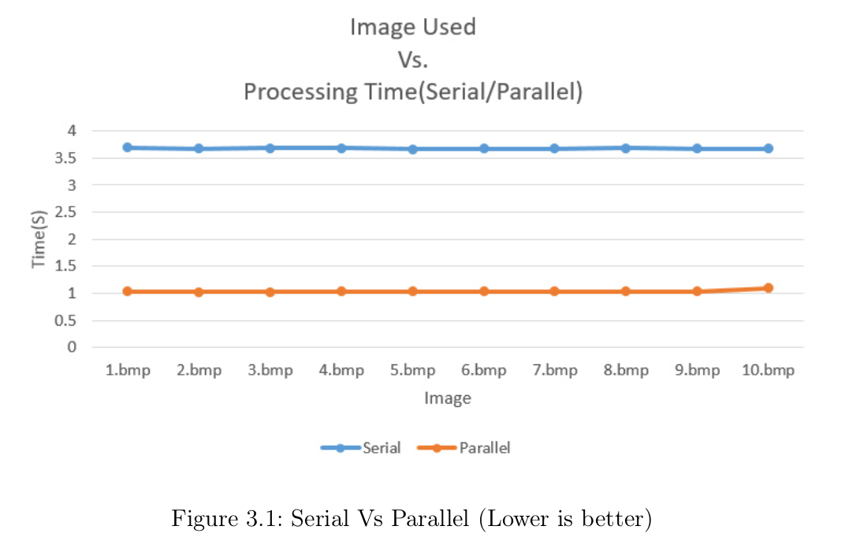
...
The above graph is just an illustration of the previous table.

Slide 6
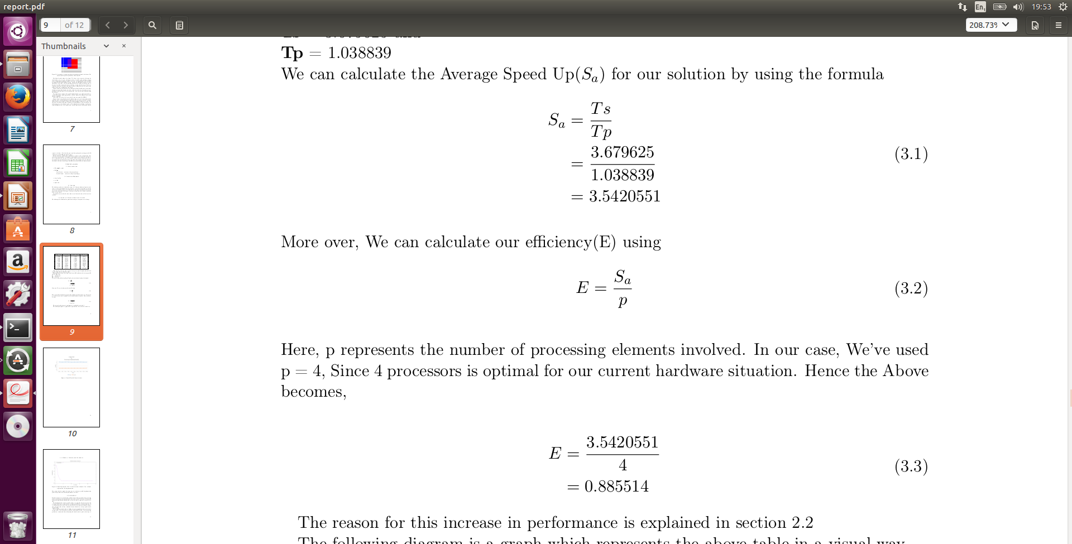
Performance metrics
If we denote the average serial time by Ts and denote the average parallel time by Tp, where
Ts = 3.679625 and Tp = 1.038839
We calculate the Average Speed Up(Sa) for our solution

Slide 7
...
More over, We can calculate our efficiency(E) using
Note: Here, p represents the number of processing elements involved. In our case, We’ve used p = 4, Since 4 processors is optimal for our current hardware situation.

Slide 8
So what does this mean?
Our speed up tells us that our parallel implentation is on average around 3.5 times faster than our serial version.
And from our Efficiency we see that each of our 4 processing elements are usefully employed for around 88% of the time

Slide 9
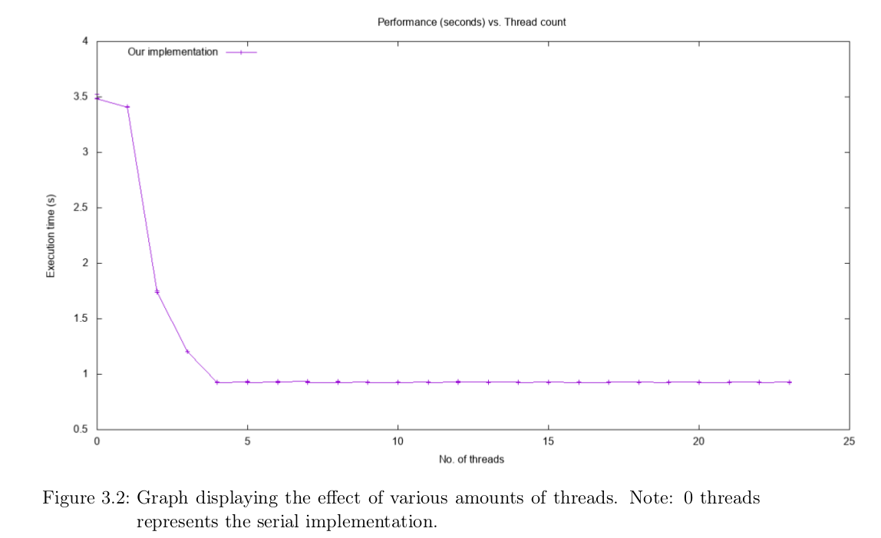
Serial vs. Parallel
(with 1-23 threads)

Slide 10
...
In the previous graph the Test image was kept constant and the number of threads were varied
It is interesting to note that after increasing the number of threads past 4(Optimal) the performance stays relatively constant.
Which makes sense in a Quad core environment
It is for this reason that the bulk of the analysis was done by considering the 4 Threads as constant and Varying the Test images.

